Slide 1


FINAL REVIEW
DEPARTMENT OF MECHANICAL ENGINEERING
AUTOMATIC RAIN PROTECTED WASHING CLOTHES
TEAM MEMBER
P. POOVARASAN (927622BME061)
K TAMILEESWARAN (927622BME098)
A L SUBIKSHANAND (927622BME090)
GUIDED BY
Mrs. D. UmaMaheshwari( M,.E )

Slide 2
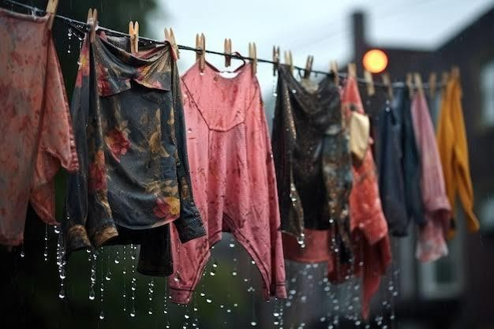
INTRODUCTION
A rain is a device designed to alert users to impending rainfall, helping them take timely actions to protect outdoor activities or belongings.
By monitoring weather patterns and detecting changes in humidity and atmospheric conditions, rain alarms provide advance warning of rain.
This can be particularly useful for managing tasks such as outdoor laundry, gardening, or planning events, ensuring that individuals can avoid unexpected disruptions and safeguard their outdoor assets

Slide 3
Abstract :
This innovative system integrates rain-sensing technology, automated washing and drying mechanisms, and waterproof clothing design. Smart Rain Wear detects rainfall, triggering automatic washing and drying cycles, ensuring garments remain clean and dry. Key features:

Slide 4
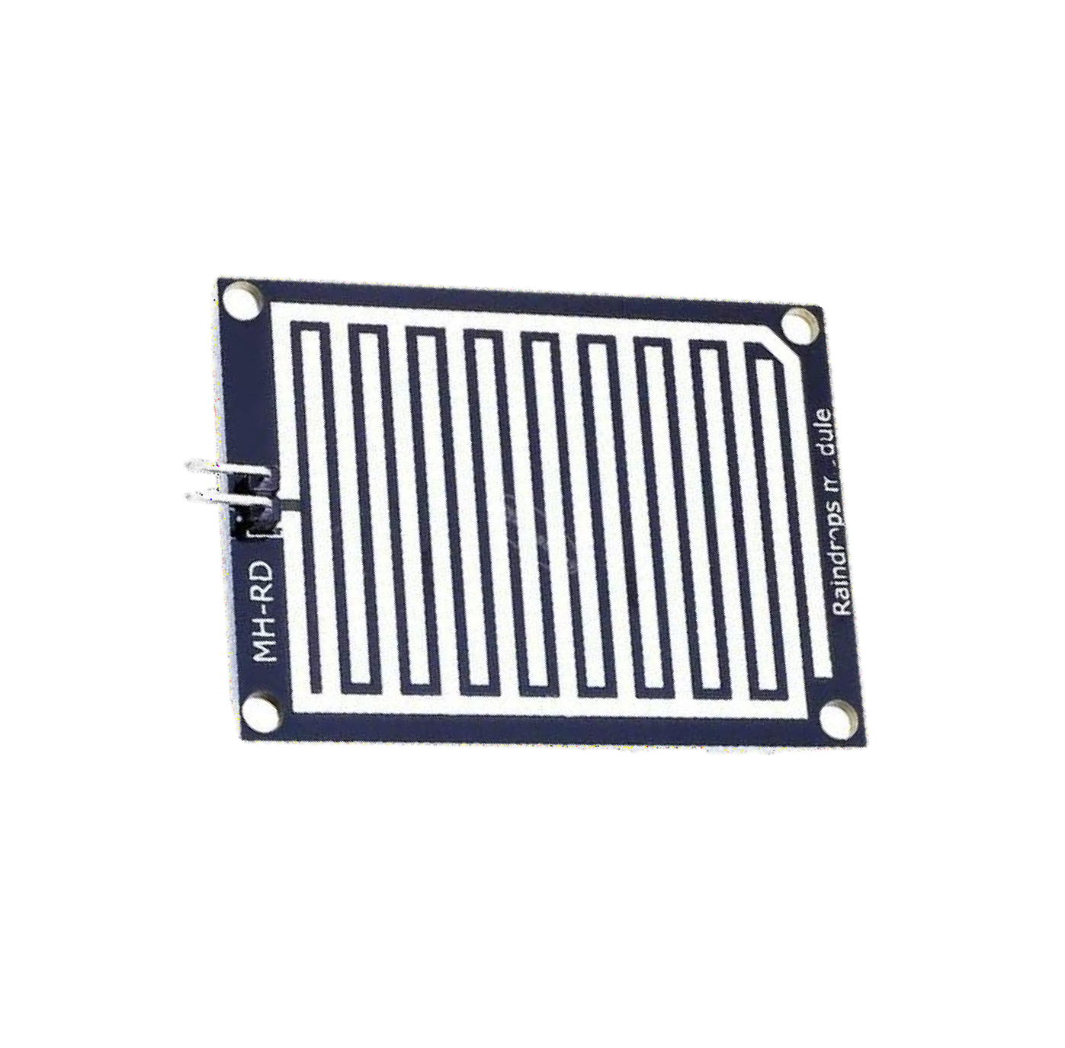
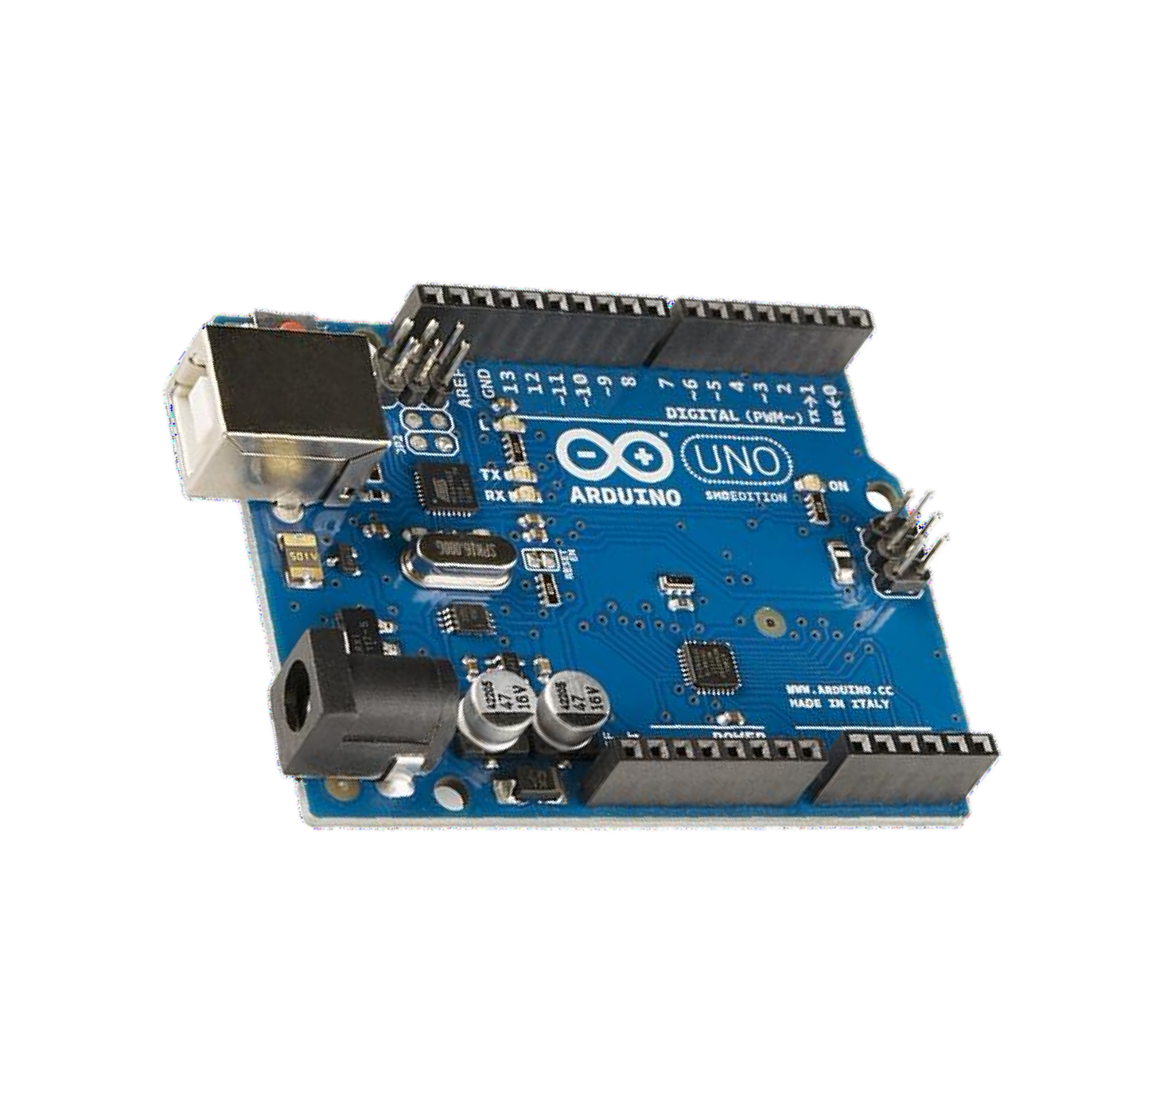
COMPONENTS AND ITS FUNCTION
A rain-sensing system detects rain and triggers actions like closing windows. Key
components include:
Rain Drop Sensor : Detects rain and sends signals.
Fig. 1
Arduino Uno : Processes signals and controls actions.
Fig. 2

Slide 5
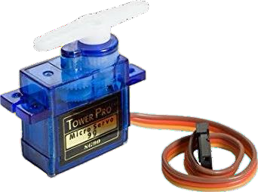
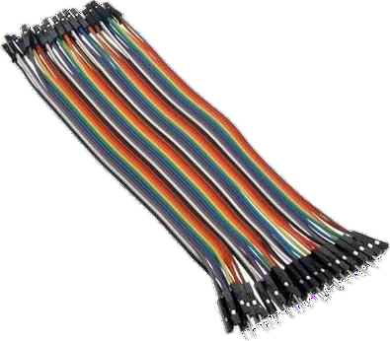
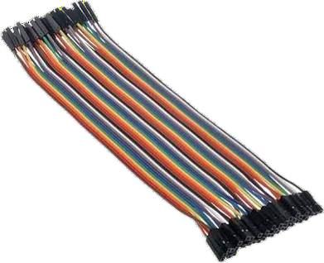
3. Servo Motor : Moves windows or covers when rain is detected.
Fig. 3
4. Jumper Wires : Connects components.
Fig. 4
(a)male to female
(b)female to female

Slide 6
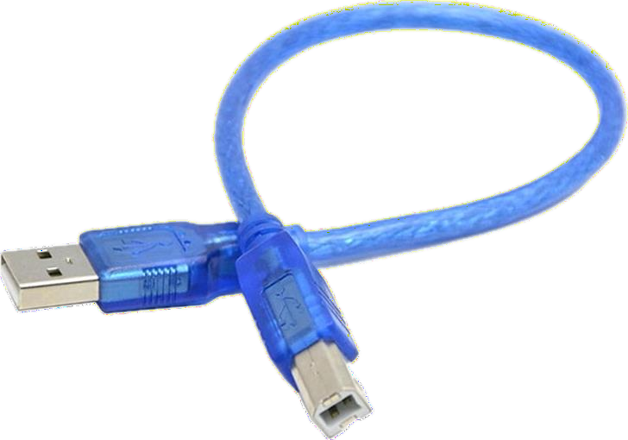
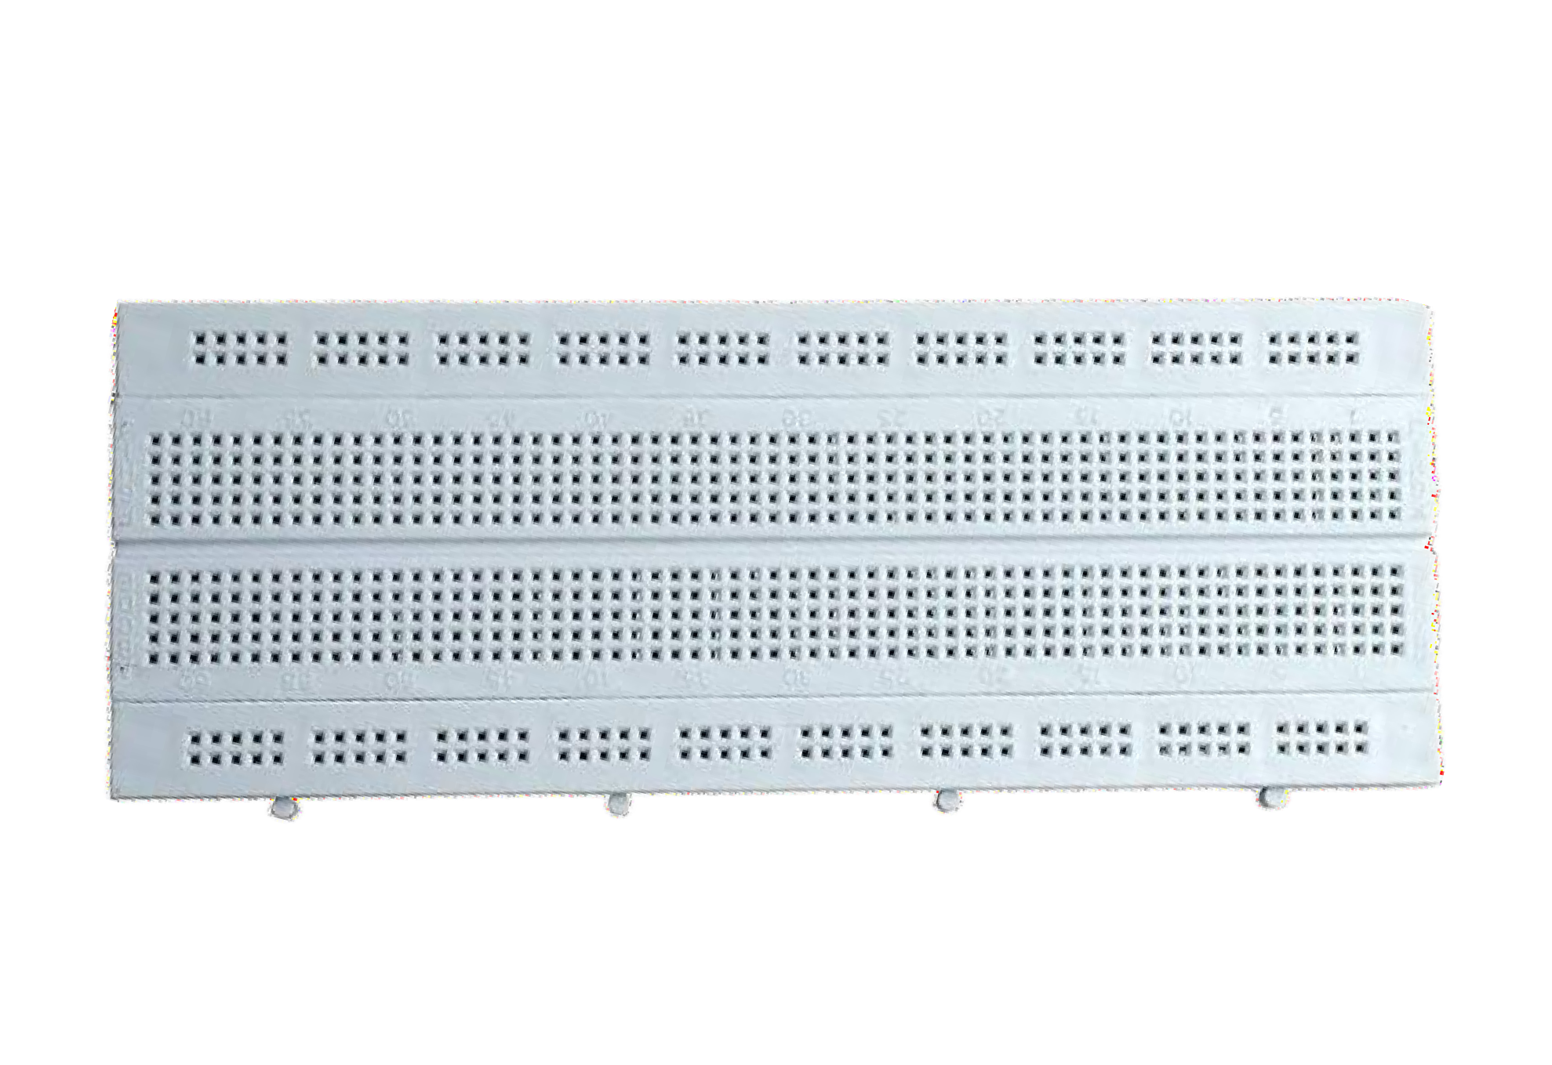
5. Arduino Cable : For programming and power supply.
Fig. 5
6. Breadboard : For easy circuit connections.
Fig. 6

Slide 7
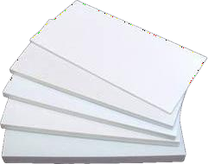
7. Sun Board Sheet : Protects electronics from rain.
Fig. 7
This system automates rain responses, ideal for smart irrigation and home automation.

Slide 8
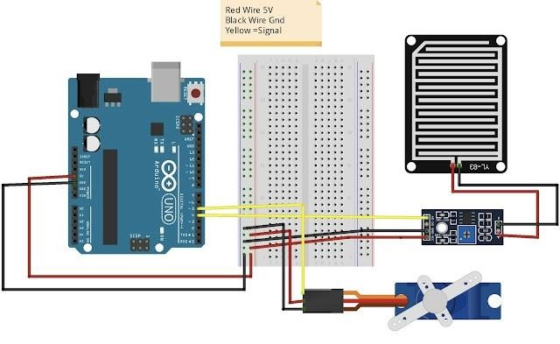
SCHEMATIC REPRESENTATION :

Slide 9
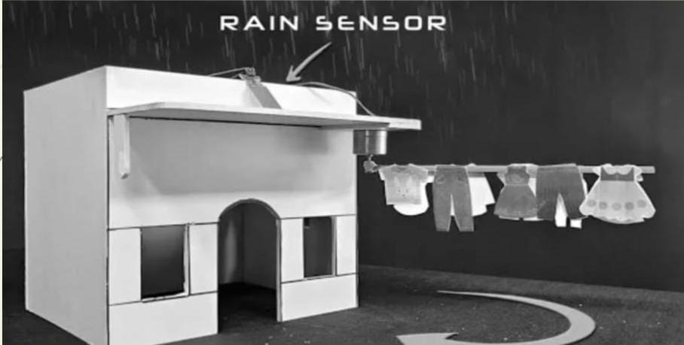

Slide 10
WORKING :
Rain Detection : The rain drop sensor detects rain and sends a signal to Arduino.
Arduino Processes : The Arduino reads the signal and triggers the servo motor.
Motor Activation : The servo motor rotates to close windows or activate covers.
Reset : When rain stops, the system resets and the servo returns to its original position.
Continuous Loop : The system monitors rain continuously, automating protection when
needed.
This setup provides real-time rain detection and response for applications like automated
rain shelters or window coverings

Slide 11
APPLICATIONS
Commercial Use :
Public Infrastructure :
Adjust streetlight brightness based on rainfall.
Automatically close public bin lids during rainfall to prevent water from entering and mixing with waste.
Event Management :
Automatically cover outdoor events.
Automatically puts up roofs or tents over seating when it starts to rain.
Personal Use :
Home Automation :
Auto-close windows and roofs
Adjust lighting and HVAC.
Gardening :
Optimize irrigation.
Protect plants from excess moisture.
Vehicle Maintenance :
Close garage doors when it rains.

Slide 12
ADVANTAGES AND DISADVANTAGES
Advantages :
Automation : Automatically detects rain and initiates protective actions.
Low Cost : Built with affordable and readily available components.
Adaptable : Easily modified for diverse applications like home automation and gardening.
Easy to Build : Straightforward setup and programming suitable for beginners.
Energy Efficient : Low power consumption, with options for solar power.
Disadvantages :
Limited Accuracy : May not effectively detect light rain or high humidity.
Environmental Exposure : Can accumulate dirt and degrade from weather exposure.
Limited Servo Strength : May struggle to move heavy covers or equipment.
Power Dependency : Requires a constant power source for operation.
Maintenance Needed : Regular cleaning and recalibration may be necessary.

Slide 13
CONCLUSION
In conclusion, the Arduino-based rain sensing system enhances home automation by automatically retracting awnings when rain is detected, protecting outdoor spaces.
It optimizes watering, reduces waste, and prevents overwatering. Additionally, it
controls greenhouse ventilation, automates rainwater harvesting, and supports pest
control, while offering mobile app connectivity for remote monitoring.
By providing environmental insights, it simplifies garden care, and its
customisable, scalable design makes it suitable for both hobbyists and
professionals in smart gardening.

Slide 14


